Slide 1
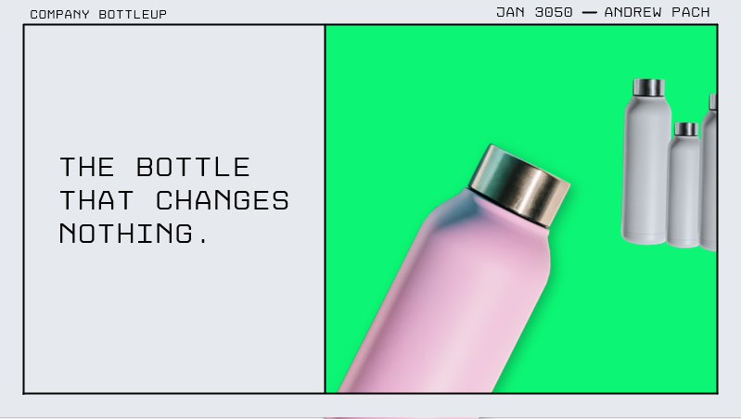

Slide 3
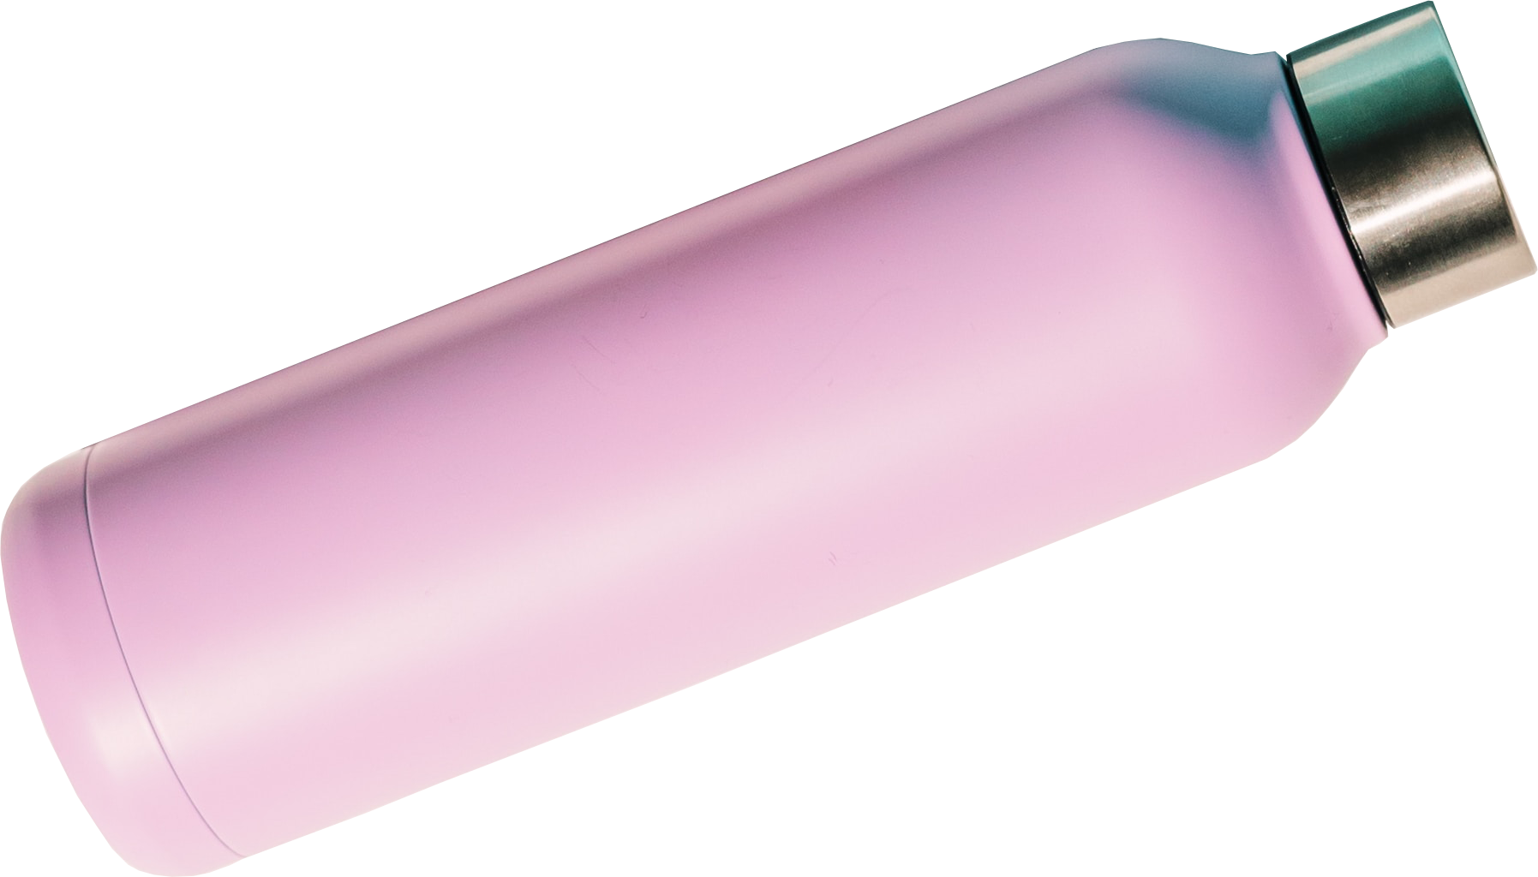
Company bottleup
Jan 3050
Andrew Pach

Slide 4
Company bottleup
Jan 3050
Andrew Pach
We are
Getting
Worse
Each year!
The bottle
That changes
Nothing.

Slide 5
The bottle
That changes
Nothing.
Company bottleup
Jan 3050
Andrew Pach
Bottle cap
We are
Getting
Worse
Each year!
Leaks and
pressure release.
Rust appears after 1 week!

Slide 6
The bottle
That changes
Nothing.
Company bottleup
Jan 3050
Andrew Pach
PRODUCT UNIT sales in MILLIONS
3050 – 3051 - 3052
We are
Getting
Worse
Each year!
-13%
-9,5%

Slide 7
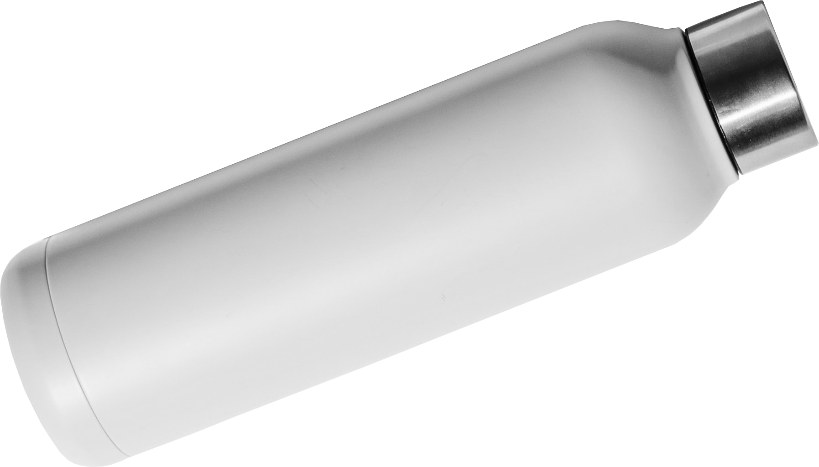
Blink 0s – 0,05
Blink 0,25s – 0,05
Blink 0,5s – 0,05
Blink 0,75s – 0,05
Blink 1s – 0,05

